Slide 1
Review 1.1
B.Tech Project (19ECE495)
Batch ID: 041
Multi-Class Classification and Detection of Knee Osteoarthritis From X- rays
MENTOR: Dr. Devi Vijayan
Dept. of Elec. and Commn. Engg.
Amrita School of Engineering, Coimbatore
CB.EN.U4ECE21008 | - | C RISHI VARDHAN REDDY
CB.EN.U4ECE21011 | - | D M SHAAHID
CB.EN.U4ECE21012 | - | DULAM SANTHOSH
CB.EN.U4ECE21033 | - | NUKALA SUMANTH

Slide 2
Motivation:
A study shows that KOA affects 1 in 5 individuals in the general population and 1 in 3 people over the age of 50. [1]
The early and accurate detection of knee osteoarthritis through advanced AI-driven methods can drastically improve patient outcomes by enabling timely interventions.
Reducing the risk of severe joint damage and enhancing the quality of life for millions of individuals affected by this debilitating condition.
Current methods for diagnosing knee osteoarthritis often misclassify early stages of the disease, leading to delayed or inappropriate treatment.
By developing an automated, accurate grading system, this project provides a reliable tool that can support clinicians in making better-informed decisions, ultimately improving patient care.

Slide 3
Problem Statement:
Knee osteoarthritis (OA) is a common joint disorder characterized by the degeneration of cartilage and underlying bone in the knee joint.
Early detection and accurate classification of knee OA severity are crucial for effective management and treatment.
Traditional diagnostic methods, such as physical examinations and X-ray imaging, can be subjective and time-consuming.
The goal is to develop an automated method for predicting knee OA severity using X-ray images, specifically classifying severity based on the Kellgren-Lawrence (KL) grading system.

Slide 4
Objective:
Develop a Computer-Aided-Diagnosis (CAD) system to assist medical professionals in early and accurate Knee-OA diagnosis.
Utilize deep learning models to automatically classify knee osteoarthritis severity into five grades (G-0 to G-4) according to the Kellgren and Lawrence system.
Implement Grad-CAM to visualize and interpret key regions in knee X-rays that influence the model's predictions, improving transparency and clinical decision-making.
Validate and compare the deep learning model's performance against state-of-the-art models.

Slide 5
Data Preparation:
Dataset[2]:
The dataset used in the study is based on the Osteoarthritis Initiative (OAI) dataset.
The dataset contains 8,260 X-ray images of knee joints, graded according to the Kellgren-Lawrence (KL) grading scheme. The distribution of the dataset across KL grades is as follows:
  Grade 0: 3,253 images
  Grade 1: 1,495 images
  Grade 2: 2,175 images
  Grade 3: 1,086 images
  Grade 4: 251 images

Slide 6
Data Preparation:
 | GRADE 0 | GRADE 1 | GRADE 2 | GRADE 3 | GRADE 4
TEST | 639 | 296 | 447 | 223 | 51
TRAIN | 2286 | 1046 | 1516 | 757 | 173
EVALUATION | 328 | 153 | 212 | 106 | 27
TOTAL | 3253 | 1495 | 2175 | 1086 | 251
• The image dimensions are 224x224 pixels.

Slide 7
Data Preprocessing:
Histogram equalization
Normal Image
Quantum noise reduction
Processed Image
Unsharp masking
Augmented Image

Slide 8
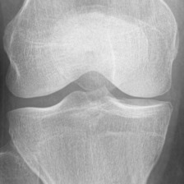
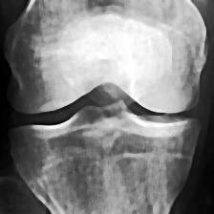
Grade0(Normal):
Normal Image Processed Image
Performance Metrics:
MSE: 15.053611288265307
PSNR: 36.35439663301513 dB
SSIM: 0.8444530270262461

Slide 9
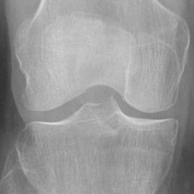
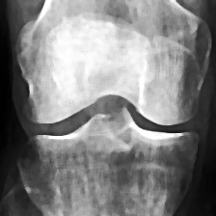
Grade1(Doubtful):
Normal Image Processed Image
Performance Metrics:
MSE: 9.233119419642858
PSNR: 38.47731908177804 dB SSIM: 0.8983195091226587

Slide 10
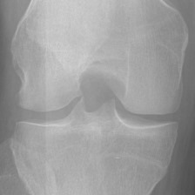
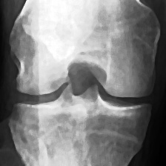
Grade2(Mild):
Normal Image Processed Image
Performance Metrics:
MSE: 4.061822385204081
PSNR: 42.04359432151725 dB
SSIM: 0.9517445428816721

Slide 11
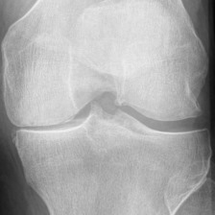
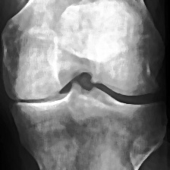
Grade3(Moderate):
Normal Image Processed Image
Performance Metrics:
MSE: 11.623485331632653
PSNR: 37.47743988980936 dB
SSIM: 0.8786653573662453

Slide 12
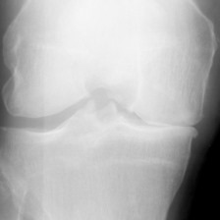
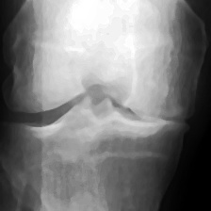
Grade4(Severe):
Normal Image Processed Image
Performance Metrics:
MSE: 1.566745057397959
PSNR: 46.18082027560162 dB
SSIM: 0.9835082716845139

Slide 13
Data Preparation:
Augmented Dataset:
 | GRADE 0 | GRADE 1 | GRADE 2 | GRADE 3 | GRADE 4
TEST | 7603 | 2784 | 3886 | 2170 | 539
TRAIN | 9187 | 6857 | 8134 | 5694 | 1748
EVALUATION | 3054 | 1551 | 2066 | 1093 | 290
TOTAL | 19844 | 11192 | 14086 | 8957 | 2577
• 56,656 augmented images of dimensions 224x224.

Slide 14
Literature
Sl. # | Title of the paper | Source | Inferences
1 | Knee osteoarthritis severity prediction using an attentive multi-scale deep convolutional neural network [3] | Springer Link | The study combines HRNet and attention mechanisms to enhance knee osteoarthritis prediction, offering greater accuracy and efficiency than remaining methods.
2 | Fully automatic knee osteoarthritis severity grading using deep neural networks with a novel ordinal loss [4] | ScienceDirect | This paper presents a two-stage deep learning approach that integrates a YOLOv2-based knee joint detection with a fine-tuned CNN using a novel ordinal loss function to automatically classify knee osteoarthritis severity, achieving state-of-the-art performance.
3 | Classification and Risk Estimation of Osteoarthritis Using Deep Learning Methods [5] | ScienceDirect | The study provides a promising approach for automated OA classification and risk estimation, with potential for further refinement in clinical applications.
4 | A complex network based approach for knee Osteoarthritis detection: Data from the Osteoarthritis initiative [6] | ScienceDirect | The study opens new avenues for further research, particularly in exploring other regions of the knee and optimizing network parameters to enhance the detection and classification of OA.

Slide 15
Literature
Sl. # | Title of the paper | Source | Inferences
5 | Knee Osteoarthritis Detection and Classification Using X-Rays [7] | ResearchGate | The paper presents a deep learning method for knee osteoarthritis detection and classification from X-rays, using an ensemble model for high accuracy and early diagnosis.
6 | Automatic Detection of Knee Osteoarthritis Disease with the Developed CNN, NCA and SVM Based Hybrid Model [8] | ResearchGate | The study proposes an automated deep learning-based ordinal classification approach for early diagnosis and grading of knee osteoarthritis using X-ray images.
7 | Optimized feature selection for enhanced accuracy in knee osteoarthritis detection and severity classification with machine learning [9] | ScienceDirect | The study infers that using optimized feature selection techniques, like Particle Swarm Optimization (PSO) and Genetic Bee Colony (GBC), significantly improves the accuracy and reliability of machine learning models for detecting and classifying knee osteoarthritis.
8 | DC-AAE: Dual channel adversarial autoencoder with multitask learning for KL-grade classification in knee radiographs [10] | ScienceDirect | The proposed DC-AAE with multitask learning significantly enhances knee osteoarthritis (OA) KL-grade classification by utilizing both labelled and unlabelled data, enhancing diagnostic accuracy and robustness.
Notes:
The ensemble model achieved 98% accuracy and a 0.99 Quadratic Weighted Kappa score for classifying knee osteoarthritis severity from X-ray images.

Slide 16
Literature
Sl. # | Title of the paper | Source | Inferences
9 | KOA-CCTNet: An Enhanced Knee Osteoarthritis Grade Assessment Framework Using Modified Compact Convolutional Transformer Model [11] | IEEE Xplore | The KOA-CCTNet model, based on a modified compact convolutional transformer, showed superior performance over other models in accurately grading knee osteoarthritis from X-ray images.
10 | Accurate, Automated Classification of Radiographic Knee Osteoarthritis Severity Using a Novel Method of Deep Learning: Plug-in Modules [12] | Springer Link | The paper presents an automated deep learning model using plug-in modules (PIM) that accurately classifies knee osteoarthritis severity, improving diagnostic consistency and efficiency based on radiographic images.

Slide 17
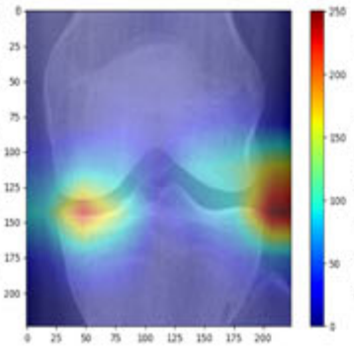
Methodology:
Visualization of Extracted Features by Grad-CAM
Input X-ray
Predicted
Grade
Grad-CAM
HRNet
VGG
DenseNet
Learned Features
ResNet

Slide 18
Deliverables:
This project develops an automated grading system for early, accurate knee osteoarthritis diagnosis, improving patient outcomes and aiding clinical decisions.
Improved KOA Classification: The system enhances the accuracy of knee osteoarthritis classification through advanced techniques.
Precision Metrics: The model is evaluated using precision metrics like accuracy, precision, recall, and F1-score to measure performance.
Use of large Dataset: The project uses a large dataset to improve the model’s training and performance, ensuring better generalization.
"The system is tested and compared with other top-performing models (state-of-the-art models) to see how well it performs.

Slide 19
Timeline:
Review | Month | Milestone
1.1 | Aug 2024 | Data preparation, Data Preprocessing
1.2 | Sep 2024 | Literature survey
1.3 | Nov 2024 | Building of classification model
2.1 | Jan 2025 | Validation and performance comparison, Paper draft
2.2 | Mar 2025 | Paper Draft
2.3 | May 2025 (External Review) | Project Report / Dissertation

Slide 20
Summary:
Early Detection of KOA: Detecting knee osteoarthritis (KOA) at early stages and starting treatment is beneficial for patients.
Assisting Doctors: The CAD system helps doctors by allowing them to focus on more serious cases and assists with faster, more accurate diagnoses.
Dataset Used: The project uses an existing dataset of 8260 X-ray images.
Data Preprocessing: Data preprocessing was done to enhance the quality of the X-ray images.
Data Augmentation: Data augmentation techniques were incorporated to further improve the performance.

Slide 21
References:
A. Mobasheri, C. S. Thudium, A.-C. Bay-Jensen, T. Maleitzke, S. Geissler, G. N. Duda, and T. Winkler, "Biomarkers for osteoarthritis: Current status and future prospects," Best Practice & Research Clinical Rheumatology, vol. 37, p. 101852, June 2023.
Chen P (2018) Knee osteoarthritis severity grading dataset.
R. K. Jain, P. K. Sharma, S. Gaj, A. Sur, and P. Ghosh, "Knee osteoarthritis severity prediction using an attentive multi-scale deep convolutional neural network," Multimedia Tools and Applications, vol. 83, pp. 6925–6942, June 2023.
P. Chen, L. Gao, X. Shi, K. Allen, and L. Yang, "Fully automatic knee osteoarthritis severity grading using deep neural networks with a novel ordinal loss," Computerized Medical Imaging and Graphics, vol. 75, pp. 84-92, June 2019.
A. R. Patil and S. Salunkhe, "Classification and Risk Estimation of Osteoarthritis Using Deep Learning Methods," Measurement: Sensors, vol. 2024, 2024, Art. no. 101279, doi: 10.1016/j.measen.2024.101279
L. C. Ribas, R. Riad, R. Jennane, and O. M. Bruno, "A Complex Network Based Approach for Knee Osteoarthritis Detection: Data from the Osteoarthritis Initiative," Biomed. Signal Process. Control, vol. 71, 2022, Art. no. 103133, doi: 10.1016/j.bspc.2021.103133

Slide 22
References:
T. Tariq, Z. Suhail, and Z. Nawaz, "Knee Osteoarthritis Detection and Classification Using X-Rays," in IEEE Access, vol. 11, pp. 48292-48303, May 2023.
S. Aslan, "Automatic Detection of Knee Osteoarthritis Disease with the Developed CNN, NCA and SVM Based Hybrid Model," in Traitement du Signal, vol. 40, no. 1, pp. 317-326, Feb. 2023.
A. S. C. Bose, C. Srinivasan, and I. J. S., "Optimized feature selection for enhanced accuracy in knee osteoarthritis detection and severity classification with machine learning," Biomed. Signal Process. Control, vol. 97, pp. 106670, Aug. 2024.
M. U. Farooq, Z. Ullah, A. Khan, and J. Gwak, "DC-AAE: Dual channel adversarial autoencoder with multitask learning for KL-grade classification in knee radiographs," Computers in Biology and Medicine, vol. 167, pp. 107570, 2023.
M. Jahan, M. Z. Hasan, I. J. Samia, K. Fatema, M. A. H. Rony, M. S. Arefin, and A. Moustafa, "KOA-CCTNet: An Enhanced Knee Osteoarthritis Grade Assessment Framework Using Modified Compact Convolutional Transformer Model," IEEE Access, vol. 12, pp. 107719-107738, July 2024.
D. W. Lee, D. S. Song, H.-S. Han, and D. H. Ro, "Accurate, automated classification of radiographic knee osteoarthritis severity using a novel method of deep learning: Plug-in modules," Knee Surgery & Related Research, vol. 36, no. 24, pp. 1–11, 2024.

Slide 23
Thank You

